Slide 1
How to Get Your CVPR Paper Rejected?
Ming-Hsuan Yang

Slide 2
Outline
Conferences
Journals
Writing
Presentation
Lessons

Slide 3
Conferences
CVPR – Computer Vision and Pattern Recognition, since 1983
Annual, held in US
ICCV – International Conference on Computer Vision, since 1987
Every other year, alternate in 3 continents
ECCV – European Conference on Computer Vision, since 1990
Every other year, held in Europe

Slide 4
Conferences
ACCV – Asian Conference on Computer Vision
BMVC – British Machine Vision Conference
ICPR – International Conference on Pattern Recognition
SIGGRAPH
NIPS – Neural Information Processing Systems

Slide 5
Conferences
MICCAI – Medical Image Computing and Computer-Assisted Intervention
FG – IEEE Conference on Automatic Face and Gesture Recognition
ICCP – IEEE International Conference on Computational Photography
ICML – International Conference on Machine Learning
IJCAI, AAAI, MVA, ICDR, ICVS, DAGM, CAIP, ICRA, ICASSP, ICIP, SPIE, DCC, WACV, 3DPVT, ACM Multimedia, ICME, …

Slide 6
Conference Location

Slide 7
Conference Location
Me and confernece I want to attend (location vs reputation)

Slide 8
Conference Organization
General chairs: administration
Program chairs: handling papers
Area chairs:
Assign reviewers
Read reviews and rebuttals
Consolidation reports
Recommendation
Reviewers
Authors

Slide 9
Review Process
Submission
CVPR/ECCV/ICCV
Double blind review
Program chairs: assign papers to area chairs
Area chairs: assign papers to reviewers
Rebuttal
Results

Slide 10
Area Chair Meetings
2 day meetings
Several panels
Each paper is reviewed by at least 2 area chairs
Buddy system
Area chair make recommendations
Program chairs make final decisions

Slide 11
Triage
Area chairs know the reviewers
Reviews are weighted
Based on reviews and rebuttal
Accept: (decide oral later)
Reject: don’t waste time
Go either way: lots of papers
Usually agree with reviewers but anything can happen as long as there are good justifications

Slide 12
Conference Acceptance Rate
ICCV/CVPR/ECCV: ~ 25%
ACCV (2009): ~ 30%
NIPS: ~ 25%
BMVC: ~ 30%
ICIP: ~ 45%
ICPR: ~ 55%
Disclaimer
low acceptance rate = high quality?

Slide 13
CVPR
Submission
Oral
Overall

Slide 14
ICCV
Submission
Oral
Overall

Slide 15
ECCV
Submission
Oral
Overall

Slide 16
Top 100 Publications - English
For what it is worth (h5 index by Google Scholar)
Nature
The New England Journal of Medicine
Science
…
63. IEEE Conference on Computer Vision and Pattern Recognition (CVPR)
…

Slide 17
Top Publications - E&CS
Nano Letters
…
7. IEEE Conference on Computer Vision and Pattern Recognition (CVPR)
...
13. IEEE Transactions on Pattern Analysis and Machine Intelligence
…

Slide 18
Reactions
Top journal papers
Workshops vs conferences
Waiting for the review and results
Acceptance
Reject
Mixed feeling
Finding an error
Resubmit?
This time, it will go through
Paper finally accepted
Registration
Oral presentation
Poster presentation

Slide 19
Database Community
Jeffrey Naughton’s ICDE 2010 keynote
What’s wrong with the reviewing process?
How to fix that?

Slide 20
Journals
PAMI – IEEE Transactions on Pattern Analysis and Machine Intelligence, since 1979 (impact factor: 5.96, #1 in all engineering and AI, top-ranked IEEE and CS journal)
IJCV – International Journal on Computer Vision, since 1988 (impact factor: 5.36, #2 in all engineering and AI)
CVIU – Computer Vision and Image Understanding, since 1972 (impact factor: 2.20)

Slide 21
Journals
IVC – Image and Vision Computing
TIP – IEEE Transactions on Image Processing
TMI- IEEE Transactions on Medical Imaging
MVA – Machine Vision and Applications
PR – Pattern Recognition
TMM – IEEE Transactions on Multimedia
…

Slide 22
PAMI Reviewing Process
Editor-in-chief (EIC) assigns papers to associate editors (AE)
AE assigns reviewers
First-round review: 3-6 months
Accept as is
Accept with minor revision
Major revision
Resubmit as new
Reject

Slide 23
PAMI Reviewing Process
Second-round review: 2-4 months
Accept as is
Accept with minor revision
Reject
EIC makes final decision
Overall turn-around time: 6 to 12 months
Rule of thumb: 15% additional work beyond a CVPR/ICCV/ECCV paper

Slide 24
IJCV/CVIU Reviewing Process
Similar formats
CVIU has roughly the same turn-around time as PAMI
IJCV tends to have longer turn-around time

Slide 25
Journal Acceptance Rate
PAMI, IJCV: ~ 20% (my guess, no stats)
CVIU: ~ 30%

Slide 26
From Conferences to Journals
How much additional work?
30% additional more work for PAMI?
As long as the journal version is significantly different from the conference one
Novelty of each work
Some reviewers still argue against this
Editors usually accept paper with the same ideas

Slide 27
How to Get Your Paper Rejected?
Jim Kajia (SIGGRAPH 93 papers chair): How to get your SIGGRAPH paper rejected?
Do not
Pay attention to review process
Put yourself from a reviewer’s perspective
Put the work in right context
Carry out sufficient amount of experiments
Compare with state-of-the-art algorithms
Pay attention to writing

Slide 28
Review Form
Summary
Overall Rating
Definite accept, weakly accept, borderline, weakly reject, definite reject
Novelty
Very original, original, minor originality, has been done before
Importance/relevance
Of broad interest, interesting to a subarea, interesting only to a small number of attendees, out of CVPR scope

Slide 29
Review Form
Clarity of presentation
Reads very well, is clear enough, difficult to read, unreadable
Technical correctness
Definite correct, probably correct but did not check completely, contains rectifiable errors, has major problems
Experimental validation
Excellent validation or N/A (a theoretical paper), limited but convincing, lacking in some aspects, insufficient validation
Additional comments
Reviewer’s name

Slide 30
Learn from Reviewing Process
Learn how others/you can pick apart a paper
Learn from other’s mistakes
Get to see other reviewers evaluate the same paper
See how authors rebut comments
Learn how to write good papers
Learn what it takes to get a paper published

Slide 31
Put Yourself as Reviewer
Reviewer’s perspective
How a paper gets rejected?
What are the contributions?
Does it advance the science in the filed?
Why you should accept this paper?
Is this paper a case study?
Is this paper interesting?
Who is the audience?

Slide 32
Experimental Validation
Common data set
Baseline experiment
Killer data set
Large scale experiment
Evaluation metric
Side effects
Comparisons

Slide 33
Compare With State of the Art
Do your homework
Need to know what is out there
Need to show why one’s method outperforms others, and in what way?
speed?
accuracy?
sensitive to parameters?
assumption
easy to implement?
general application?

Slide 34
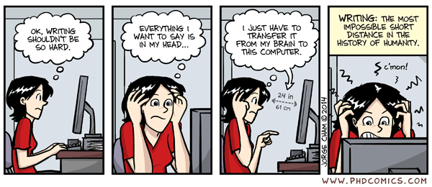
Writing

Slide 35
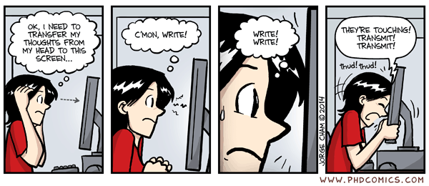
Writing

Slide 36
Writing
Reviewing a poorly written paper
Clear presentation
Terse
Careful about wording
Make claims with strong evidence

Slide 37
Writing
Matt Welsh’s blog on scientific writing
Sharpen your mental focus
Force you to obsess over every meticulous detail – word choice, word count, overall tone, readability of graphs (and others such as font size, layout and spacing, and page limit)

Slide 38
Writing
Crystalizing the ideas through the process of putting things together
Hone the paper to a razor-sharp, articulate, polished work

Slide 39
Writing
Write the paper as early as possible, sometimes before even starting the research work
Will discover the important things that you have not thought about
The process of writing results in a flood of ideas

Slide 40
Writing
Even if a paper is not accepted, the process is energizing and often lead to new ideas for the next research problems
Submitting the paper is often the start of a new line of work
Riding on that clarity of thought would emerge post-deadline (and a much-needed break)

Slide 41
Tell A Good Story
Good ideas and convincing results
But not too much (vs grant proposal)

Slide 42
Presentation
Good artists copy, great artists steal
Not just sugar coating
Not just a good spin
Tell a convincing story with solid evidence
Present your ideas with style
Q&A
Real stories

Slide 43
Interesting Title
Cool titles attract people
Grab people’s attention
Buzz word?
But don’t be provocative

Slide 44
Math Equations
Minimal number of equations
No more, no less
Too many details simply make a paper inaccessible
Too few equations
Many good papers have no or few equations
CVPR 13 best paper
CVPR 05 HOG paper

Slide 45
Figures
Be clear
Sufficient number of figures

Slide 46
Theoretical or Applied?
Computer vision is more applied, at least nowadays
Theory vs real world
More high impact papers are about how to get things done right

Slide 47
Common Mistakes
typos
“a”, “the”
inanimate objects with verbs
inconsistent usage of words

Slide 48
Get Results First than Writing?
Conventional mode
Idea-> Do research -> Write paper
“How to write a great research paper” by Simon Peyton Jones
Idea -> Write paper -> Do research
Forces us to be clear, focused
Crystallizes what we don’t understand
Opens the way to dialogue with others: reality check, critique, and collaboration
My take
Idea -> Write paper -> Do research -> Revise paper -> Do research -> Revise paper -> …

Slide 49
Supplementary Material
Important
Add more results and large figures
Add technical details as necessary (don’t miss important details)
Derivation details, e.g., proof of a theorem

Slide 50
Most Important Factors
Novelty
Significant contributions (vs. salami publishing)
Make sure your paper is non-rejectable (above the bar with some error margin)

Slide 51
Rebuttal or Response
Anything can happen:
Good surprise:
One CVPR paper: BR, BR, DR
Two ECCV papers: PR, PR, BR
Bad surprise:
Two ECCV papers: PA, PA, BR

Slide 52
Challenging Issues
Large scale
CVPR 2011 best paper: pose estimation
CVPR 2013 best paper: object detection
Unconstrained
Real-time
CVPR 2001: face detector
CVPR 2006: scalable object recognition
Robustness
Recover from failure

Slide 53
Interesting Stats
Best papers and top cited papers in computer science
Best papers = high impact?
Oral papers are more influential?
CVPR Longuet-Hggins prize
ICCV test-of-time award

Slide 54
Data Set Selection
NIPS 02 by Doudou LaLoudouana and Mambobo Bonouliqui Tarare, Lupano Tecallonou Center, Selacie, Guana
The secret to publish a paper in machine learning conferences?
Read the references therein carefully!

Slide 55
Ask Someone to Proofread
Certainly your advisor
Polish your work

Slide 56
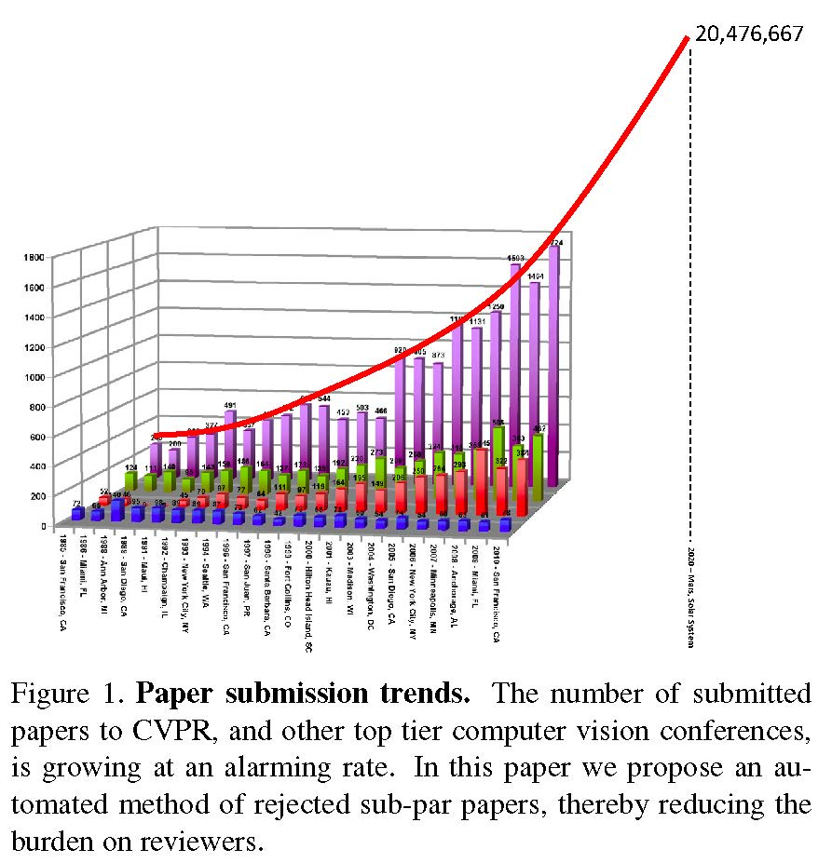
Paper Gestalt

Slide 57
Paper Gestalt
CVPR 10 by Carven von Bearnensquash, Department of Computer Science, University of Phoenix
Main Point: Get your paper looking pretty with right mix of equations, tables and figures

Slide 58
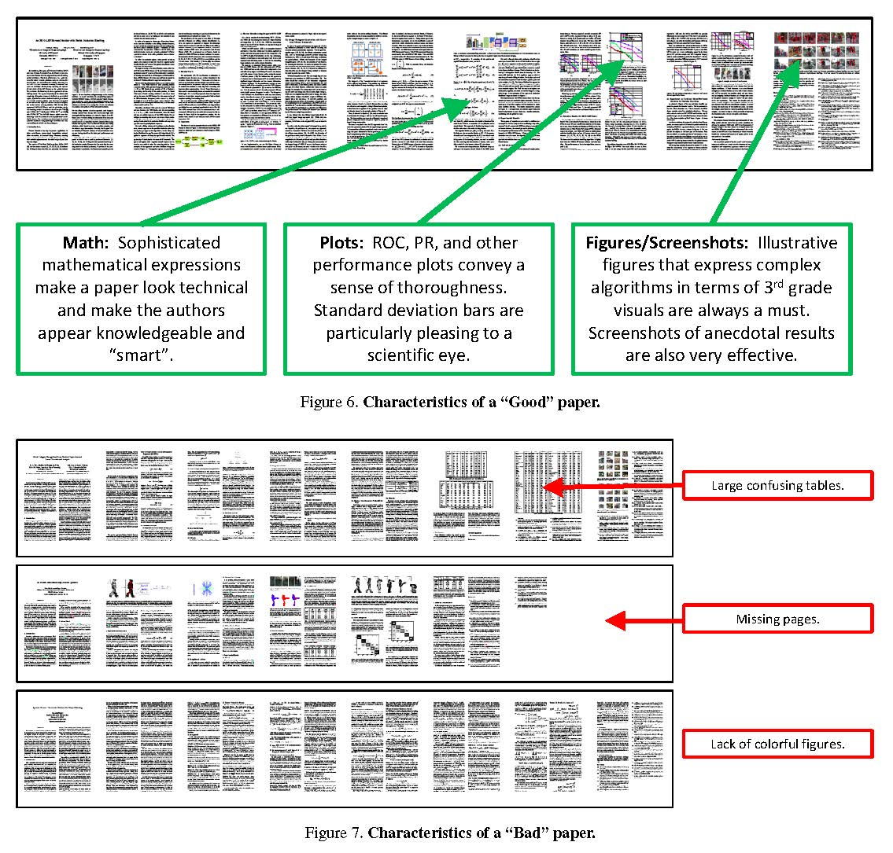

Slide 59
Tools
Google scholar, citeseer
h-index
Software: publish or perish
Disclaimer:
h index = significance?
# of citation = significance?

Slide 60
Basic Rules
Use LaTeX
Read authors’ guideline
Read reviewers’ guideline
Print out your paper – what you see may NOT be what you get
Submit paper right before deadline
Risky
Exhausting
Murphy’s law
Do not count on extension

Slide 61
Lessons
Several influential papers have been rejected once or twice
Some best papers make little impact
Never give up in the process

Slide 62
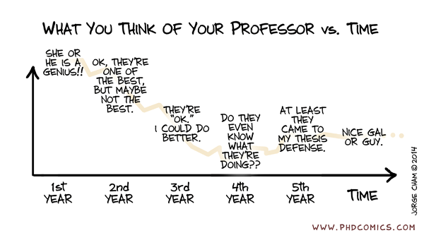
Karma?

Slide 63
Advisor and you
Suggesting a research topic
When your advisor presents your work
When you explain your work
Demos
Good results

Slide 64
Start Working Early!
Write, write, write…
Ask others for comments

Slide 65
Work Hard in the Summer

Slide 66
Quotes from Steve Jobs
"I'm convinced that about half of what separates successful entrepreneurs from the non-successful ones is pure perseverance.”
"Creativity is just connecting things. When you ask creative people how they did something, they feel a little guilty because they didn't really do it, they just saw something. It seemed obvious to them after a while.”

